Slide 1
REFACTORING
IN-CLASS PRESENTATION
Harry Pulivarthy, Tyson Diep, Chandler Juego
Notes:
Everyone

Slide 2
What is Refactoring?
Refactoring is the process of restructuring an existing body of code, altering its internal structure without changing its external behavior.
Refactoring consists of a series of small behavior-preserving transformations.
Individual transformations do little, but a sequence of refactorings can produce a significant restructuring.
Since each refactoring is small, it's less likely to go wrong. The system is kept fully working after each refactoring, reducing the chances that a system can get seriously broken during the restructuring.
Notes:
Chandler [2 m]
Talk about the difficulties with reading people’s code (or your own), especially on projects you haven’t touched in a while
Could be writing code that works at the time and is very specific without much consideration of future use cases that may arise
Or it could simply be code that is hard to read due to arbitrary values and sequences of code whose relations are hard to discern
Restructuring the code without changing its behavior – goal is to make the code more general and improve maintainability of code over time
Done through small individual factors or transformations to ensure that the system does not break from a major refactor

Slide 3
—MARTIN FOWLER
“Whenever I have to think to understand what the code is doing, I ask myself if I can refactor the code to make that understanding more apparent.”
Notes:
Chandler [30 s]
Call back to real-life example from previous slide

Slide 4

Basic Examples: Inline Variable
The Inline Variable refactoring involves replacing a temporary variable with its initial expression.
If the temporary variable is not used multiple times, this refactoring can make the code more concise.
int basePrice = anOrder.basePrice;
return (basePrice > 1000);
return anOrder.basePrice > 1000;
Notes:
Harry

Slide 5
Basic Examples: Replace Magic Literal
The Replace Magic Literal refactoring replaces hard-coded literal values in code with named constants or variables.
This refactoring makes the code easier to understand and centralizes the definition of constants, making it simpler to update them in the future.
function potentialEnergy(mass, height) {
return mass * 9.81 * height;
}
const STANDARD_GRAVITY = 9.81;
function potentialEnergy(mass, height) {
return mass * STANDARD_GRAVITY * height;
}
Notes:
Harry

Slide 6
Ex: Refactoring for Unnecessary Code
The Remove Middle Man refactoring eliminates unnecessary layers of abstraction by directly accessing the desired functionality or data, instead of going through an intermediate object or method.
manager = aPerson.manager;
class Person {
getManager() {return this.department.manager;}
manager = aPerson.department.manager;
Notes:
Harry

Slide 7
Ex: Refactoring for Unnecessary Code
The Parameterize Function refactoring modifies a function to accept additional parameters, allowing for increased flexibility and reuse.
function tenPercentRaise(aPerson) {
aPerson.salary = aPerson.salary.multiply(1.1);
}
function fivePercentRaise(aPerson) {
aPerson.salary = aPerson.salary.multiply(1.05);
}
function raise(aPerson, factor) {
aPerson.salary = aPerson.salary.multiply(1 + factor);
}
Notes:
Harry

Slide 8
Ex: Refactoring for Exceptions
The Replace Exception with Precheck refactoring involves anticipating potential errors before they occur and handling them preemptively through validation or checks, rather than relying on error codes or exceptions.
double getValueForPeriod (int periodNumber) {
try {
return values[periodNumber];
} catch (ArrayIndexOutOfBoundsException e) {
return 0;
}
}
double getValueForPeriod (int periodNumber) {
return (periodNumber >= values.length) ? 0 : values[periodNumber];
}
Notes:
Harry

Slide 9

Ex: Refactoring with Classes
The Replace Conditional with Polymorphism refactoring replaces complex conditional logic with polymorphic behavior, achieved through inheritance and method overriding.
switch (bird.type) {
case 'EuropeanSwallow':
return "average";
case 'AfricanSwallow':
return (bird.numberOfCoconuts > 2) ? "tired" : "average";
default:
return "unknown";
class EuropeanSwallow {
get plumage() {
return "average";
}
class AfricanSwallow {
get plumage() {
return (this.numberOfCoconuts > 2) ? "tired" : "average";
}
Notes:
Harry

Slide 10
The Catalog of Refactorings
Martin Fowler, along with Kent Beck, introduced the concept of refactoring in their seminal book Refactoring: Improving the Design of Existing Code.
Fowler's Catalog of Refactorings (link below) provides a comprehensive list of specific techniques for restructuring code while preserving its behavior.
The catalog is organized into categories based on the types of improvements they address, making it easier for developers to navigate and find relevant techniques for their codebase.
Catalog of Refactorings: https://refactoring.com/catalog/
Notes:
Harry

Slide 11
Opposite Refactorings
Refactorings are highly context-dependant because ultimately, they exist to help the programmer. Although there are general best practices, the decision of whether or not to refactor is often subjective.
Consider the first example: Inline Variable. This refactoring replaces a temporary variable with its initial expression. However, if the temporary variable is used 10 times, should we implement this refactoring and recompute the initial expression each time?
In this situation, the Inline Variable refactoring may not make much sense. Instead, we can refer to the opposite refactoring of Inline Variable, which is Extract Variable/Introduce Variable. This refactoring breaks down complex expressions into separate variables with descriptive names.
Opposite refactorings exist because no refactoring technique is a one-size-fits-all solution.
Notes:
Chandler [2 m]
Refactorings are context-dependent, and it is important to know what refactoring technique is appropriate according to the state of the code.
Take the first ‘Inline variable’ example from the previous slides:
You can convert the use of a variable into a single line, but just because you can cut the # of lines for that action, it doesn’t mean you should do it
In another situation, this inline variable refactoring may not make sense if the variable is used multiple times
Instead, we can do the opposite refactoring technique, ‘Extract Variable’, which turns repeated expressions/difficult to understand expressions into another variable
These opposite refactorings exist because the refactoring technique that should be used on a snippet of code depends on the greater context

Slide 12
The Need for Refactoring
When should we refactor?
Code smells: when code exhibits signs of poor design, such as duplicated code, long functions, or complex conditional logic.
Performance issues: when code is hindered by performance bottlenecks or loses efficiency due to reduced maintainability.
Consequences of not refactoring:
Less maintainability: difficult to ensure that the functionality remains bug-free.
Less extensible: difficult to add features or functionality to existing code.
Notes:
Chandler [2 m]
Refactoring should be considered as an ongoing process throughout the development cycle.
Some situations where refactoring is beneficial is:
Code smells: indications of poorly structured/inefficient code (e.g., duplication, long methods, complex conditional logic)
Perhaps more difficult to decide on whether to refactor is on performance optimization: when the performance of the code can be improved with more optimized algorithms, but it is also important to maintain readability. Simple example of this is with the fibonacci sequence to an n number of terms – you can implement the straightforward way or the more efficient way which utilizes memoization to store previously calculated Fibonaci numbers to avoid redundant computations, but it may be less readable at first sight due to the additional complexity. Again, the refactoring decision is context dependent and the programmer should think about how important this efficiency improvement is.
Consequences of not refactoring include less maintainability
More difficult to identify bugs or potential issues with the code, especially as the code becomes more complex and difficult to understand over time. I.e., the “code smells” add up on each other over time and increase the difficulty of improving upon the code.
Less extensible or less agile
No refactoring leads to code becoming too rigid with very narrow functions. This makes it less adaptable and more difficult to add on new features due to poor modularity, readability, and understanding of how the current system is tied together.

Slide 13
The Importance of Refactoring
—MARTIN FOWLER
Refactoring is key to maintaining code readability, maintainability, and extensibility.
Without refactoring, codebases tend to accumulate technical debt, leading to an increased risk of bugs.
Technical debt refers to the accumulated cost that arises when shortcuts or suboptimal solutions are employed in software development. It can manifest in code smells, dependency issues, suboptimal architecture, and many other forms.
“When you find you have to add a feature to a program, and the program’s code is not structured in a convenient way to add the feature, first refactor the program to make it easy to add the feature, then add the feature.”
Notes:
Chandler [2 m]

Slide 14
Case Study: An Empirical Study of Refactoring Rhythms and Tactics in the Software Development Process
This is a study of the relationship between different refactoring rhythms and code quality (i.e. reducing code smells).
Refactoring rhythms describe how refactoring operations are divided across the weekdays and usually focus on existing tasks.
An all-day refactoring rhythm is one where there is no statistically significant difference in the density of refactoring among the different days of the week (according to the Kruskal Wallis test)
84% of examined projects use all-day refactoring.
A work-day refactoring rhythm is one where the median refactoring density is significantly higher in workdays compared to weekends.
11% of examined projects use work-day refactoring.
Refactoring tactics are referred to as long-term refactoring more focused on future development.
Root canal refactoring is identified by occasional refactoring aside from the development process.
Floss refactoring is distinguished by frequent refactoring along with the development process.
Notes:
Harry

Slide 15
Case Study: An Empirical Study of Refactoring Rhythms and Tactics in the Software Development Process
Refactoring rhythms do not have a significant impact on code quality. The two most common refactoring rhythms studied in this paper are all-day and work-day refactoring rhythms.
Different refactoring tactics have different impacts on code quality: root canal-based refactoring is more likely than floss-based refactoring to be associated with better code quality.
Root canal-based tactics lead to an average decrease in the frequency of code smells for 28 out of 35 code smell types studied.
Floss-based tactics lead to an average increase in the frequency of code smells.
“...We propose the inclusion of dedicated refactoring tasks within the development timeline. While this approach may necessitate additional time investment, it proves beneficial for developers to conduct long-term maintenance tasks on code quality.”
Notes:
Harry

Slide 16
Principles of Refactoring
—MARTIN FOWLER
Best practices for refactoring include:
Make incremental changes to minimize the risk of introducing bugs
Utilize version control to ensure that changes can be rolled back
Document important refactoring decisions, rationale, and outcomes for future developers
Practice TDD and run tests frequently to ensure that functionality is preserved.
“If you can get today’s work done today, but you do it in such a way that you can’t possibly get tomorrow’s work done tomorrow, then you lose.”
Notes:
Chandler [1 m]

Slide 17
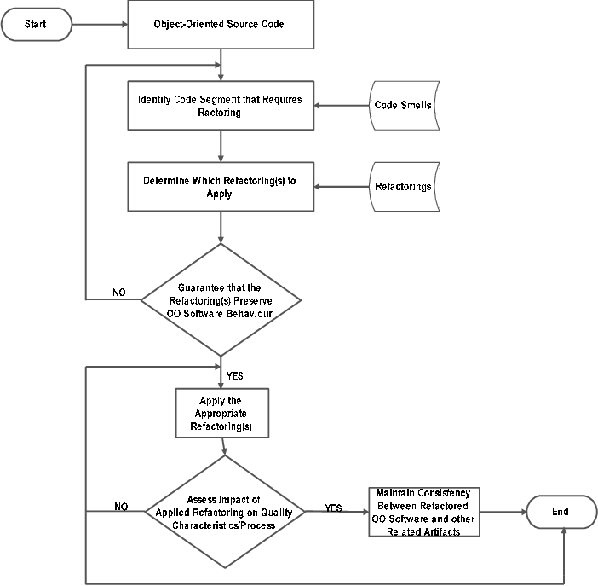
The Refactoring Process
Notes:
Chandler [3 m]
Isong, Bassey & Dladlu, Nosipho & Ele, Bassey. (2016). Object-Oriented Code Metric-Based Refactoring Opportunities Identification Approaches: analysis. 10.1109/ACIT-CSII-BCD.2016.24.

Slide 18
Refactoring in JetBrains Rider
JetBrains Rider provides a toolbox of built-in refactorings. It also has intelligent code analysis to provide context-aware suggestions for refactoring.
Rider can use the ReSharper plugin with seamless integration.
Rider allows developers to customize refactorings, keyboard shortcuts, and code analysis settings to match their preferences and workflows.
Find more information about Refactoring in JetBrains Rider here:
https://www.jetbrains.com/help/rider/Refactorings__Index.html.
This includes instructions to refactor and common keyboard shortcuts.
Notes:
Tyson

Slide 19
Refactoring in Visual Studio
Visual Studio includes a robust set of tools for 60+ refactorings via the ReSharper plugin, including:
Rename: Easily rename variables, methods, classes, or other symbols across the entire solution
Extract Method: Extract code fragments into separate methods
Move Type: Move classes or types to different namespaces or projects
ReSharper conducts on-the-fly code quality analysis and provides real-time suggestions and warnings for potential refactorings, which can be accessed directly from the context menu or via keyboard shortcuts.
You can configure and apply code style based on your personal preferences or your team standard.
Notes:
Tyson

Slide 20
Conclusion
Refactoring is the process of improving the internal quality of software without affecting its functionalities.
We should refactor when our program has code smells or performance issues. If we don’t refactor, our code becomes less readable, maintainable, and extensible over time.
We should set aside dedicated time to refactor rather than only incorporating it into other tasks (root canal-based approach vs floss-based approach).
When refactoring, remember to make incremental changes, use version control, document your changes, and use test-driven development.
Time for the coding demo!
Notes:
Tyson

